Slide 1
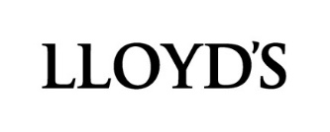
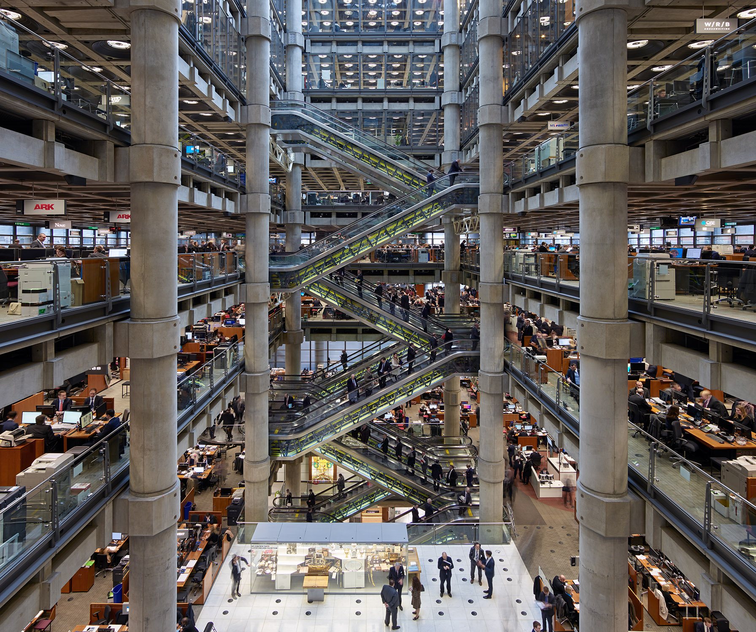
Compartir
riesgos
para crear un
mundo mas
valiente
www.lloyds.com

Slide 2



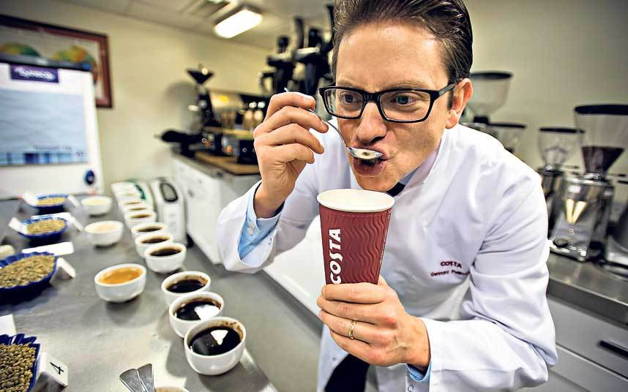


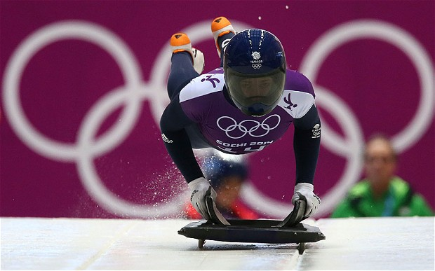



El mercado de Lloyd’s es conocido por sus coberturas especializadas
y un apetito por riesgos que requieren soluciones innovadoras
Notes:
2
Coffee tongue - Lloyd's has insured Costa Coffee's Italian Master of Coffee's tongue
http://www.lloyds.com/News-and-Insight/News-and-Features/Specialist/Specialist-2009/Costas_chief_taster_insured_for_10_million_09032009
American football
http://www.lloyds.com/news-and-insight/news-and-features/market-news/industry-news-2013/a-league-of-its-own
More recently, hair for the Head & Shoulder’s division of Procter & Gamble
http://www.lloyds.com/News-and-Insight/News-and-Features/Market-news/Specialist-2010/Lloyds-puts-1m-price-on-Polamalus-head
Ilja Gort has insured his nose for €5m.
A Dutch wine maker has insured his nose for €5m to cover against any incident that could threaten his livelihood.
http://www.lloyds.com/News-and-Insight/News-and-Features/Market-news/Specialist-2008/Gort_nose_Lloyds_cover_makes_sense_19032008 - GREAT BBC VIDEO INTERVIEW ON THIS LINK
Extreme Exploration
The Catlin Arctic Survey has successfully concluded following more than two months of scientific research, with the final samples taken at the North Pole. A team of three experienced polar explorers, led by record breaking adventurer Ann Daniels, reached the Geographic North Pole on May 12 having spent 60 gruelling days trekking across the polar ice, taking valuable scientific readings as they went. http://www.lloyds.com/news-and-insight/news-and-features/environment/environment-2010/catlin-arctic-survey-2010-ends-on-a-high
Formula One
http://www.lloyds.com/news-and-insight/news-and-features/market-news/industry-news-2013/the-changing-risk-of-formula-one
Olympic Sized Risks
http://www.lloyds.com/news-and-insight/news-and-features/market-news/industry-news-2014/olympic-sized-risks
Oscar jewels
http://www.lloyds.com/News-and-Insight/News-and-Features/Market-news/Specialist-2008/Jewels_and_dresses_worthy_of_iconic_status_16012008
Betty Grable
In the 1940s executives at 20th Century Fox had the legs of Betty Grable insured at Lloyd’s for $1 million each.
Rolling Stones’ guitarist Keith Richards.
http://www.lloyds.com/News-and-Insight/News-and-Features/Archive/2006/10/Famously_providing_insurance
Smile - Ugly Betty star America Ferrera's smile insured at Lloyd's for $10m. The policy was bought by at home teeth-whitening product Aquafresh White Trays as part of a promotion involving the celebrity which aims to raise money for US charity Smiles for Success.

Slide 3
Como funciona el Mercado de Lloyd’s?
La Corporación de Lloyd’s
Flujo del Negocio
Agente Administrador 55
Sindicatos 99
Flujo de Capital
Tomador de la poliza
    Directo
    Reaseguro
Canal de Distribution
Lloyd’s brokers 303
Coverholders 3,938
Service companies 378
Miembros
t
Last updated March 2019
Notes:
Content Owners: Nigel Williamson, Umron Ahmed, Peter Montanaro
Last updated: Annual report, 27th March 2019
Key Points
• Policyholders request insurance cover to protect themselves against risks. They approach a broker and explain their needs.
• Lloyd’s brokers are regulated by the national regulator, and meet Lloyd’s own eligibility criteria. They identify the underwriters best placed to insure the risk from a diverse range of syndicates – including international companies and smaller niche firms.
• Coverholders are companies authorised by a managing agent to enter into contracts of insurance – on behalf of the syndicate members.
• Managing agents manage the syndicates – employing the underwriting staff and handling the day-to-day running.
• Members provide the capital – they include some of the world’s major insurance groups, FTSE companies, individuals and limited partnerships.
• The Corporation oversees and supports the market.
Members of Lloyd's
Members provide the capital to support the syndicates’ underwriting. Members include some of the world’s major insurance groups and companies listed on the London Stock Exchange, as well as individuals and limited partnerships. Corporate members provide most of the capital for the Lloyd’s market.
Brokers - distributing the business
Lloyd’s is a broker market in which strong relationships, backed by deep expertise, play a crucial part. Brokers facilitate the risk transfer process between policyholders and underwriters. Much of this business involves face to face negotiations between brokers and underwriters.
Syndicates – writing the insurance
A Lloyd’s syndicate is formed by one or more members joining together to provide capital and accept insurance risks. Most syndicates write a range of classes of business but many will have areas of specific expertise. Syndicates are, technically, set up on an annual basis. In practice, they usually operate from year to year with members having the right, but not the obligation, to participate in syndicates the following year. This continuity of capital backing the syndicates means they function like permanent insurance operations. Each syndicate sets its own appetite for risk, develops a business plan, arranges its reinsurance protection and manages its exposures and claims.
Coverholders and service companies – offering local access to Lloyd’s
A managing agent may also authorise third parties to accept insurance risks directly on behalf of its syndicates. These businesses, known as coverholders, form a vital distribution channel, offering a local route to Lloyd’s in many territories around the world.
A service company operates like a coverholder but is a wholly owned subsidiary of a managing agent or its group. Unlike a coverholder, a service company is able to sub-delegate underwriting authority to other coverholders.
Managing agents – managing the syndicates
A managing agent is a company set up to manage one or more syndicates on behalf of the members. Managing agents have responsibility for employing underwriters, overseeing their underwriting and managing the infrastructure and day-to-day operations.
Corporation of Lloyd’s – supporting the market
The Corporation oversees the Lloyd’s market. It provides the market’s infrastructure, including services to support its efficient running, and protects and maintains its reputation.
Policyholders - transferring risk
Policyholders include businesses, organisations, other insurers and individuals from around the world who seek to mitigate the impact of potential risks. Policyholders may access the Lloyd’s market via a broker, coverholder or service company.
Info on Managing Agents and Syndicates
Numbers as at 31 December 2018 are:
Managing agents: 55
Syndicates: 84 (new synds and cessations are equal, so the headline number is unchanged)
SPAs 15 (equal to the number of SPAs at the end of 2017)
New syndicates:
1947 -Pembroke Managing Agency Limited
1975 - Coverys Managing Agency Limited
1980 - Asta Managing Agency Limited
3268 - Asta Managing Agency Limited
5623 - Beazley Furlonge Limited
6131 - Asta Managing Agency Limited
6132 - Barbican Managing Agency Limited
6133 - Apollo Syndicate Management Limited

Slide 4
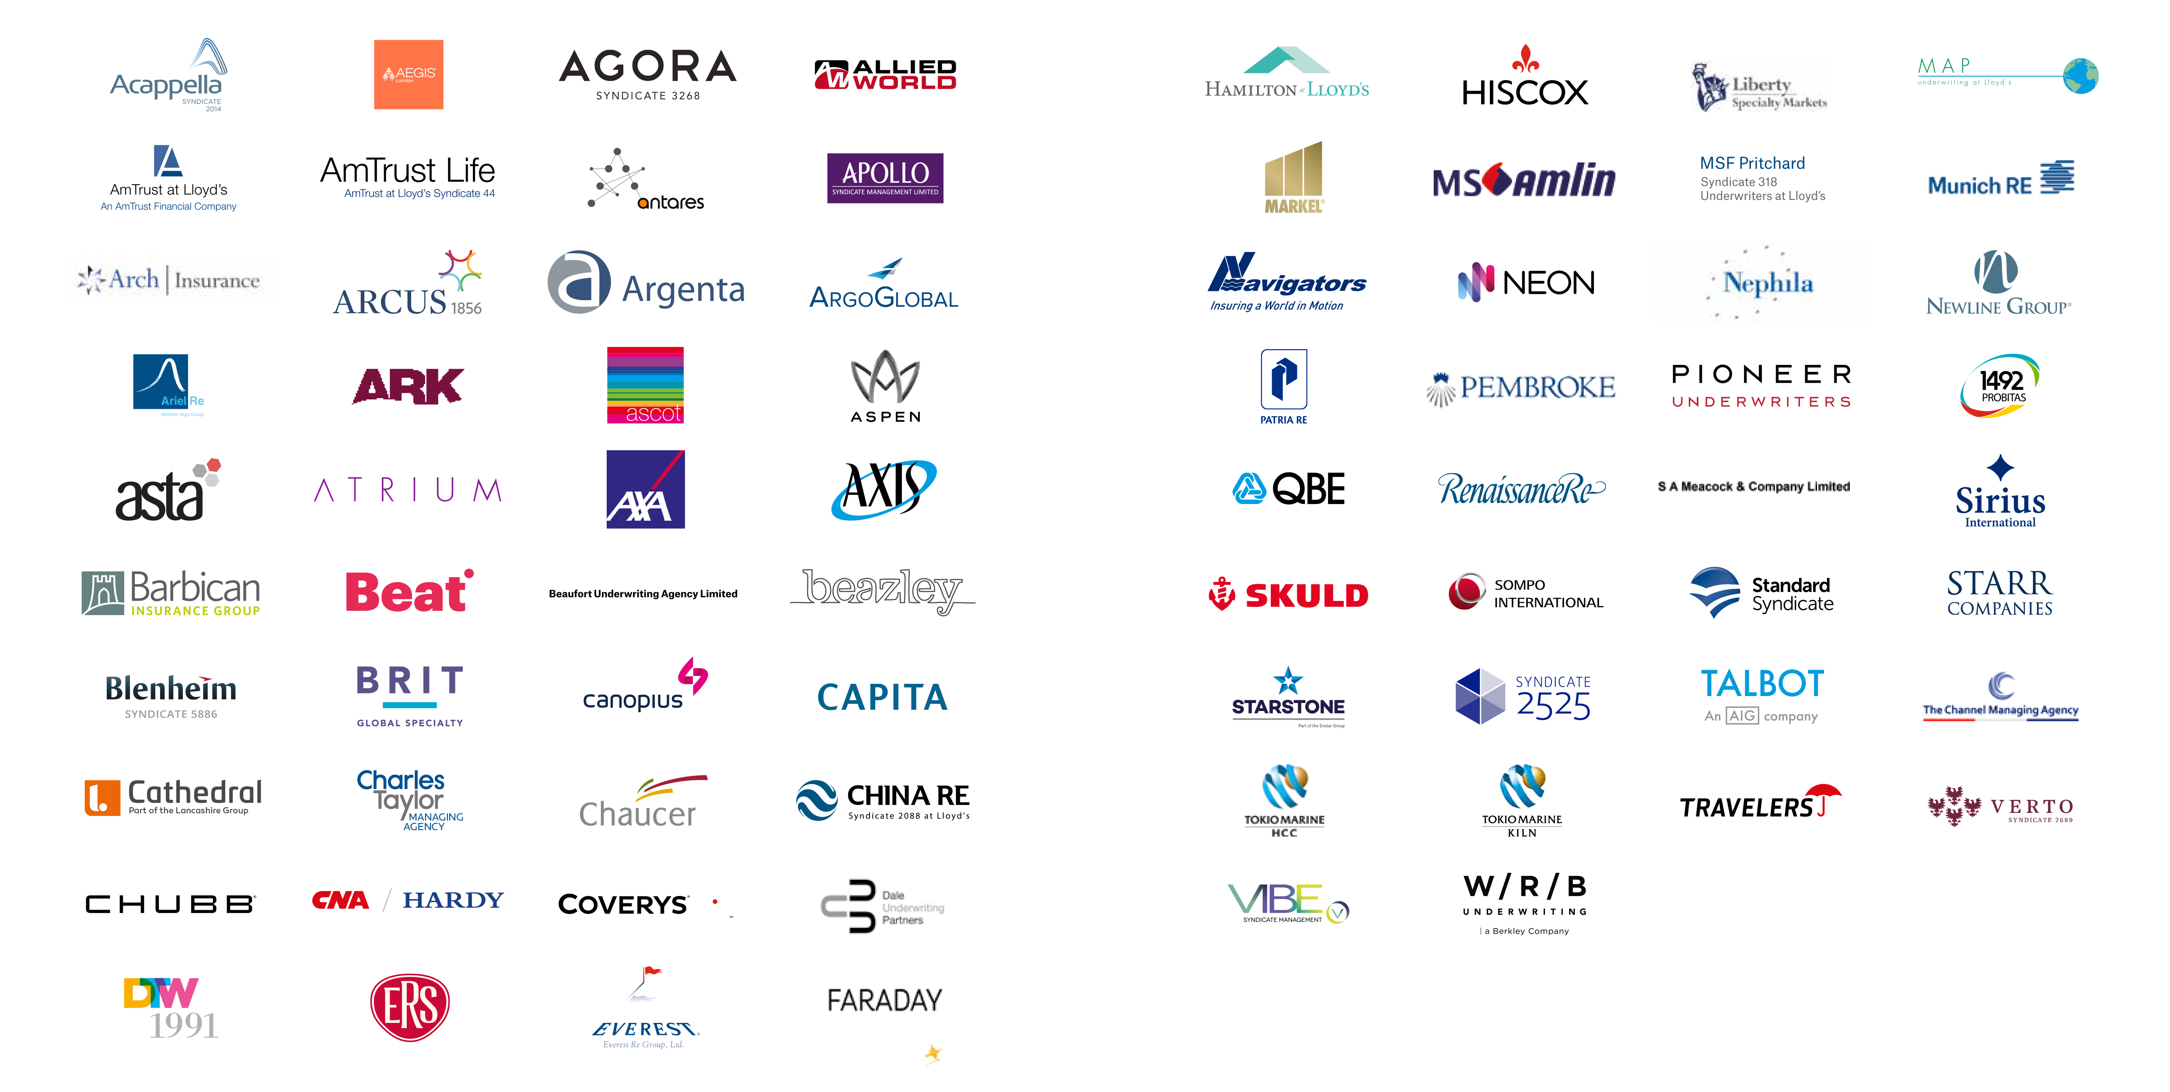
El Mercado de Lloyd’s
Hogar de las principales compañías de seguros
As of Annual Report March 2019 - lloyds.com/annualreport2018
Notes:
Updated by: Tom Hazzard
Last updated: Annual report, 22nd March 2018

Slide 5
Por qué hacer negocios a través de Lloyd’s
Lloyd’s posee varias ventajas competitivas
Acceso al Mercado | Seguridad y Calificación | Ventajas de Capital | Procesos y servicios centralizados
Acceso a los principales mercados de seguros y una red de licencias en expansión | Excelente seguridad financiera respaldada por la cadena de seguridad de Lloyd's y calificaciones sólidas capaces de atraer negocios de seguros especializados | Marco eficiente de capital impulsado por los beneficios de la mutualidad | Infraestructura que respalda el mercado de suscripción y la provisión de informes fiscales y regulatorios. Otros servicios centrales (por ejemplo, cabildeo) y la capacidad de beneficiarse de un entorno listo para Solvencia II
Oferta de Productos | Pago de Siniestros | Experiencia en Suscripción | Supervisión del Mercado
Acceso a una amplia gama de soluciones especializadas y a la medida en (rea) seguro | Reputación por el pago de todos los siniestros validos en una manera rápida y eficiente | Acceso a la experiencia e innovación en suscripción especializada | Un régimen de supervisión del mercado robusto, consistente con una cultura innovadora y emprendedora
Fortaleza y Reputación de la Marca Los beneficios de Lloyd's se basan en la marca y reputación mundial líder
Notes:
Updated by: Marketing Team
Last updated: 22nd March 2018

Slide 6
Licencias/derechos comerciales globales
Licencias/Derechos comerciales de Lloyd’s: mas de 150 países
Reaseguro Cross border
Reaseguro Cross border/Onshore en USA y seguro de líneas excedentes
Reaseguro Onshore únicamente
Seguro y Reaseguro Onshore
As of Annual Report March 2019 - lloyds.com/annualreport2018
Notes:
Last updated: March 2018
Last updated by: Daniel de Búrca, Zohir Uddin

Slide 7
Desgloce de negocios globales de Lloyd’s
Lloyd's asegura a personas, empresas y comunidades en más de 200 países y territorios
USA y Canada
51%
Reino Unido
14%
Europa
13%
Asia Central
y APAC
11%
RM
4%
Otros
America
7%
2017 primas brutas suscritas $
48Mm
As of Annual Report March 2019 - lloyds.com/annualreport2018
Notes:
Last updated: Annual report, 22nd March 2018
Updated by: Jake Tomlin, Tom Hazzard
Over the years, the Lloyd’s market has helped customers around the world withstand shock, recover and rebuild. We’re proud to continue this essential service today.
Built for an interconnected economy, Lloyd’s insures people, businesses and communities in more than 200 countries and territories.
This number will continue to grow as Lloyd’s works to develop the insurance industry in new and emerging markets.
Our global network is underpinned by the quality and expertise of local coverholders, brokers and underwriters who know the risk landscape in detail and whose expertise can provide the tailored, highly-specialised cover you need.

Slide 8
Lloyd’s en números
Sindicatos
de experiencia suscriptora especializada
Coverholders
ofreciendo acceso local a Lloyd’s
99
3,938
Brokers
llevando negocios a Lloyd’s
Service companies
en Lloyd’s, la mayoría en Reino Unido y en USA
303
378
$ miles de millones de siniestros pagados
por Lloyd’s en los últimos 5 años
Países y territorios
cubiertos por el Mercado de Lloyd’s
102
200+
Last updated March 2019 – Figures as at 31 December 2018
Notes:
Updated by Tom Hazzard/ Nigel Williamson/ Claims Team
Last updated: Annual report, 22nd March 2018
CLAIMS IN THE 21st CENTURY – net or gross??
2001 – Lloyd’s incurred a loss of $4.2 billion, its largest loss and larger than any insurer, from the World Trade Center terrorist attacks
2005 – a devastating hurricane season in the Gulf of Mexico. Lloyd’s pays out $6.8 billion to help States get back on their feet.
2011 – Lloyd’s incurred $20 billion claims due to the unprecedented level of natural catastrophes
2012 – Lloyd’s incurred $2.2 billion in claims from Superstorm Sandy in the Caribbean and North America
2014 - £12bn paid claims (gross claims paid)
2015 - £11bn paid claims (gross claims paid)
2016 - £14bn paid claims (gross claims paid)
2017 - £18bn paid claims (gross claims paid)
2015 –
Approximately £280 million (gross) worth of claims arose from catastrophe events; they made up less than 5% of the total number of open claims processed.
Claims were processed from risks placed with Lloyd’s across 233 countries and all seven continents.
Approximately 40% of the number of claims paid were on risks placed outside of the USA or UK.
Property and Marine claims make up 40% of all claims paid in 2015, with Casualty and Property claims making up over half by volume.
2016 saw major claims increase due primarily to the Fort McMurray fires in Alberta, Canada.
2017 saw further increases in claims payments due to major claims for hurricanes Harvey, Irma and Maria, among other events, there were also devastating wildfires in California, an earthquake in Mexico, monsoon flooding in Bangladesh and a mudslide in Colombia.

Slide 9
Clases de negocios en Lloyd’s
% Reaseguro
31
% Propiedad
27
% Responsabilidad Civil
25
% Marítimo
8
% Energía
4
% Auto
3
% Aviación
2
Last updated March 2019 – Figures as at 31 December 2018
Notes:
Updated by Jake Tomlin, Tom Hazzard
Last updated: Annual Report, 22nd March 2018
Lloyd’s covers more than 60 lines of insurance and reinsurance.
The market insures complex and specialist risks for companies large and small

Slide 10
Cadena de Seguridad de Lloyd’s
La estructura de capital única de Lloyd, a menudo conocida como la Cadena de Seguridad, proporciona una excelente seguridad financiera para los asegurados y eficiencia de capital para los miembros.
Diversos Activos
Eslabón uno
Activos a nivel de sindicatos
  $68Mm
Eslabón dos
Fondos de miembros de Lloyd’s
  $34Mm
Activos Mutuales
Eslabón tres
Activos Centrales
  $4Mm
As of Annual Report March 2019 - lloyds.com/annualreport2018
Notes:
Eslabón 1- Primas – mantenido en fondos a nivel de sindicato en nombre de los miembros
En términos de la compañía: Las cuentas de perdidas y ganancias
Eslabón 2 – Capital regulatorio – mantenido a nivel de miembros
Fondos en Lloyd's: activos depositados en Lloyd's y mantenidos a nivel de miembro como capital regulatorio
En términos de la compañía: 'El balance' ...... 'Cuando se ha ido, se ha ido‘
Eslabón 3 – El Fondo Central
El fondo mutuo establecido para proteger a los titulares de pólizas en caso de que se agote el fondo en Lloyds de un miembro: tenga en cuenta la posibilidad de que un miembro "recargue"
Sin equivalente en las compañía
Fuerte contribuyente a la calificación de Lloyd’s

Slide 11
Nuestras calificaciones oficiales
Las aseguradoras que operan en el mercado de Lloyd's disfrutan del beneficio de una calificación de mercado único otorgada por agencias independientes
Standard & Poor’s
(Fuerte)
Fitch Ratings
(Muy Fuerte)
A.M Best
(Excelente)
A+
AA-
A
Last updated March 2019 – Figures as at 31 December 2018
Notes:
Updated by Jake Tomlin, Tom Hazzard
Last updated: Annual Report, 22nd March 2018
Lloyd’s covers more than 60 lines of insurance and reinsurance.
The market insures complex and specialist risks for companies large and small

Slide 12
Lloyd’s
Lloyd’s en Latino América
Principales observaciones
    América Latina es un Mercado en crecimiento con un total de primas suscritas de 1,411mm de dólares en 2017
    Mexico es el Mercado mas grande de Lloyd’s en América Latina seguido por Brasil y Chile
D 2017 a 2018 las primas en Lloyd’s en Mexico crecieron un 10.4% en la región
Lloyd’s tiene presencia en Brasil, Colombia y Mexico
La mayoría de los negocios de Lloyd’s en América Latina corresponden a Reaseguro (mas del 95%)
401
Mexico
80
Colombia
Brazil
229
LATAM
USD
1,411 mn
Chile
199
Argentina
122
Notes:
The market in Central America is predominantly controlled by Mexico.
Latin America is a key growth market for Lloyd’s with USD $1.4bn GSP in 2016 – Mexico USD $343m GSP –largest market in the region -, Brazil USD $224m GSP, Chile USD $205m GSP, Argentina $150m GSP and Colombia, Peru and VeneLatin America is an expansive region with significant potential for (re)insurance growth, due to rapid development and low insurance penetration (3.1% of GDP, with non-life insurance penetration in Latin America at just 1.8% ). Latin America is a key growth market for Lloyd’s with USD $1.4bn GSP zuela USD 79m GSP each.

